Slide 1
NLP Project for Disaster Tweet Classification
Presented By
Vivek Rajput

Slide 2
Objectives:
Classification Model Development: Develop a machine learning model that can predict whether a tweet is about a real disaster or not. Accuracy and Precision: Aim for high accuracy and precision in classification to minimize false alarms and ensure timely and accurate disaster detection. Robustness: Create a model that can handle variations in language, including slang, abbreviations, and cultural nuances, to ensure effectiveness across diverse tweet datasets. Scalability: Build a scalable solution capable of processing large volumes of tweets in real-time to support continuous monitoring efforts
Key Tasks:
Part 1: Data Exploration and Preparation
Part 2: Feature Engineering and Model Selection
Part 3: Model Evaluation and Validation
Part 4: Deployment with Web Interface
Model Deployment and User Interface Design

Slide 3
What is NLP?
NLP stands for Natural Language Processing, it is the ability of a computer to understand human text and process it to give meaningful output. NLP is used in wide areas of interest ranging from setting up alarm with your voice assistant to complicated things like Google Translate and Automatic Captions in YouTube.
We are going to create a baseline NLP model with Tensor Flow
I am going to implement the model and improve upon it. This is part 1 of the NLP with Disaster Tweets series and we will gradually improve the model

Slide 4
Importing Necessary Modules
We are going to import few necessary python modules to create our model.
We will be importing the following modules:
Pandas — For data manipulation and analysis
Numpy — For array manipulation
Matplotlib.pyplot — For plotting graphs and visualising data
Seaborn — For high level visualisation
Re — For using Regular Expressions (RegEx)
Tensor Flow — For building our Neural Network

Slide 5
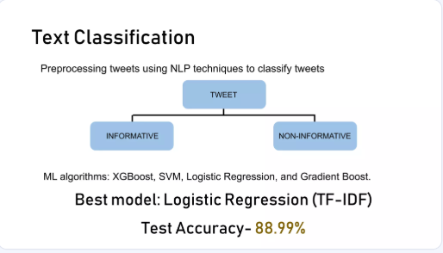
Text classification

Slide 6
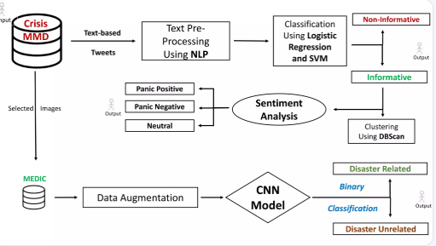
Flow chart

Slide 7
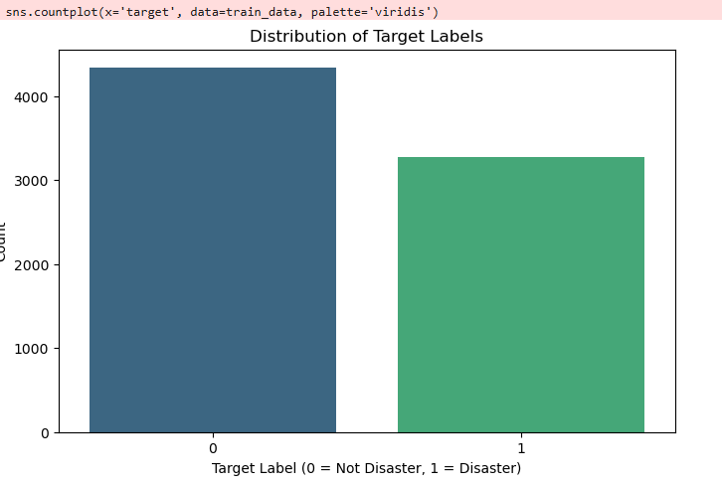
Data Distribution:

Slide 8
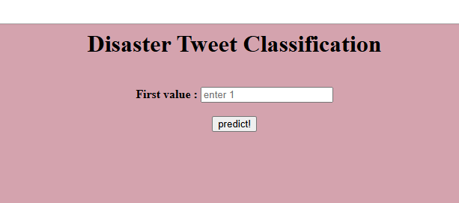
Input User Interface With Flask

Slide 9
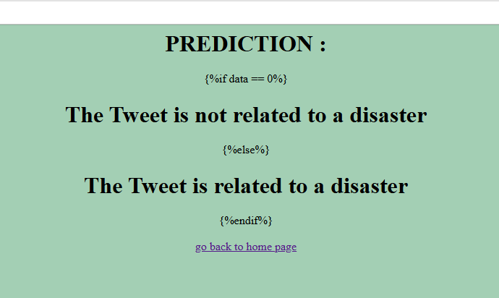
Output User Interface With Flask

Slide 10
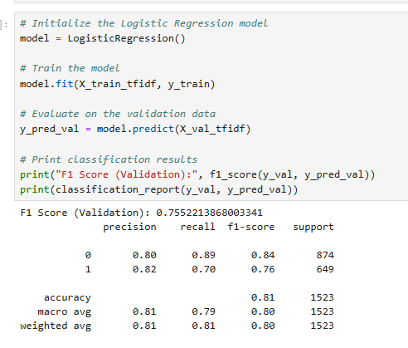
Machine Learning models for classifying Tweets data

Slide 11
Scope of Improvements
We can always use large dataset which covers almost every type of data for both machine learning and deep learning
We can use the best pertained models but they require a lot of computational power
Also there are various ways to increase model accuracy like k-fold cross validation, different data preprocessing techniques better than used here

Slide 12
Conclusion
The Data analysis and modelling was successfully done, and the Deep Learning model was deployed on Flask Web App
Please do the repository, if it helped you in anyway.
By successfully developing and deploying a machine learning model for classifying disaster related tweets, we can enhance the ability to detect and respond to emergencies more efficiently. This project represents a valuable opportunity to leverage NLP techniques for the greater good, contributing to the advancement of disaster management and public safety efforts.

Slide 13
Thank You

